Slide 1
Logistic Regression & SVM

Slide 2
Intro…..
Logistic regression is one of the most popular Machine Learning algorithms, which comes under the Supervised Learning technique. It is used for predicting the categorical dependent variable using a given set of independent variables.
Logistic regression predicts the output of a categorical dependent variable. Therefore the outcome must be a categorical or discrete value. It can be either Yes or No, 0 or 1, true or False, etc. but instead of giving the exact value as 0 and 1, it gives the probabilistic values which lie between 0 and 1.
Logistic Regression is much similar to the Linear Regression except that how they are used. Linear Regression is used for solving Regression problems, whereas Logistic regression is used for solving the classification problems.

Slide 3
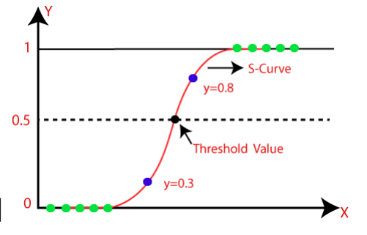
In Logistic regression, instead of fitting a regression line, we fit an "S" shaped logistic function, which predicts two maximum values (0 or 1).

Slide 4
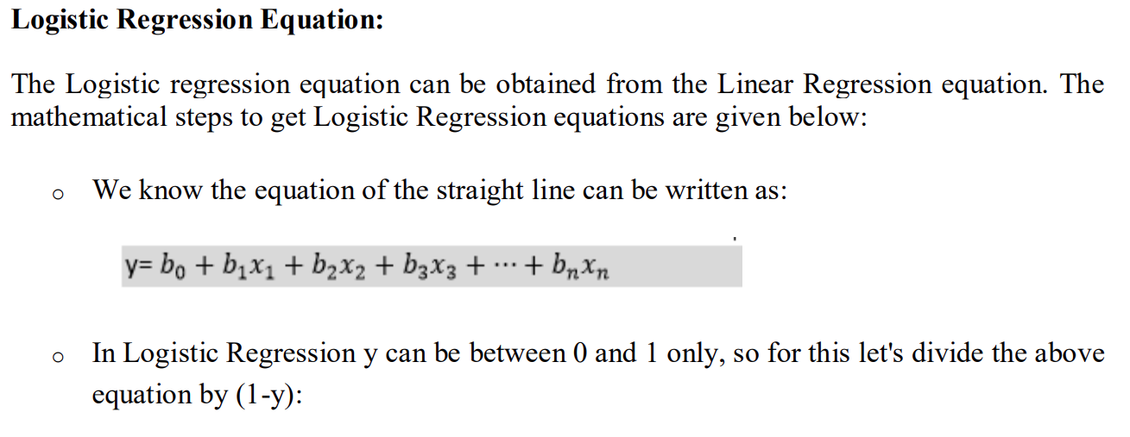
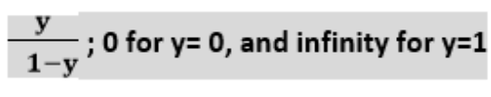
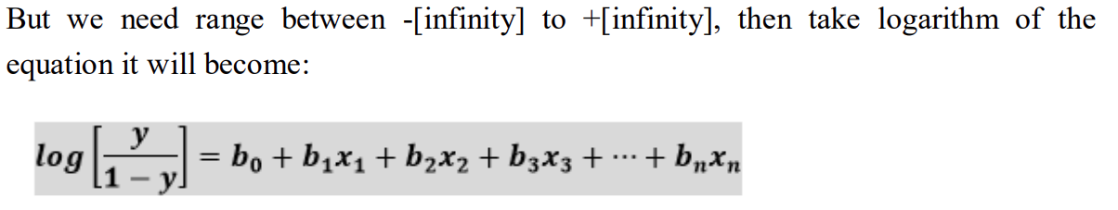

Slide 5
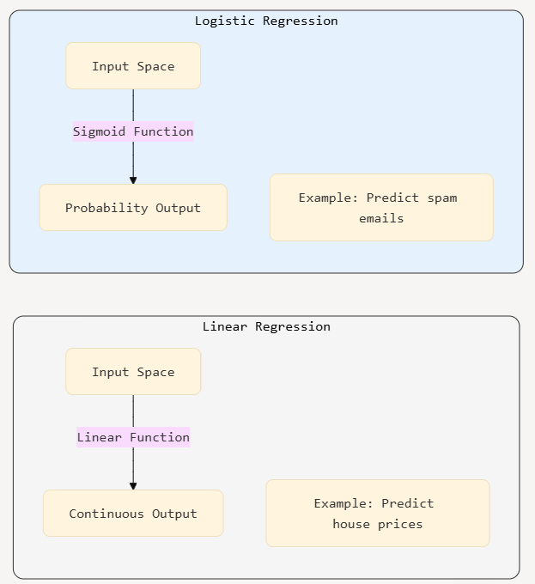

Slide 6
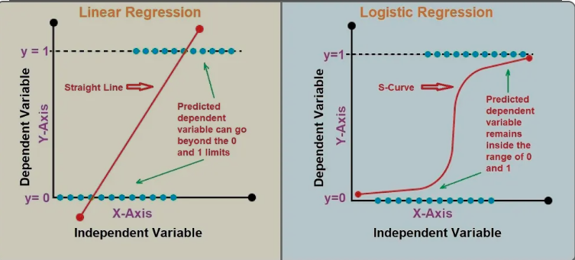

Slide 7
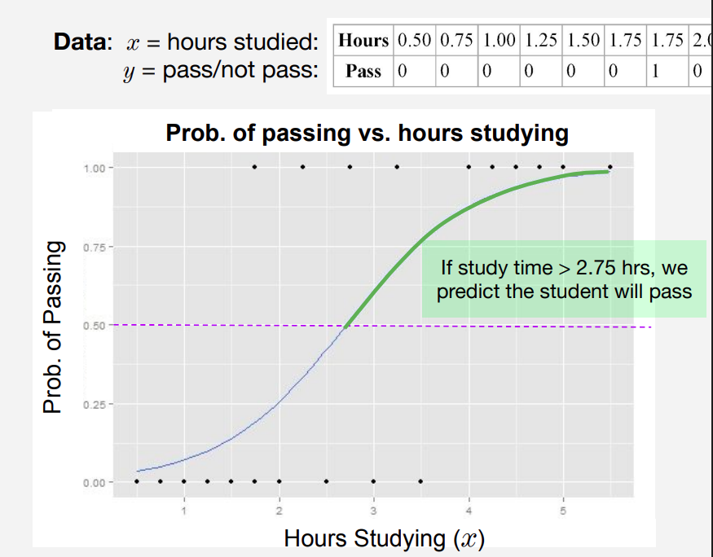
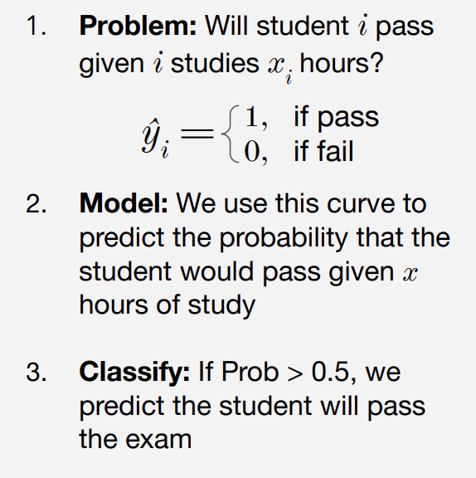
Classification Example…..

Slide 8
Support Vector Machine

Slide 9
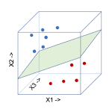
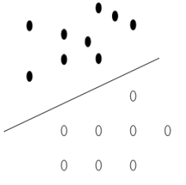
Support vector machine (SVM in short) is a Discriminant based classification method where the task is to find a decision boundary separating sample in one class from the other. it is a binary in nature, means it considers two classes.
In the 3D space, the decision boundary is a hyperplane
In the 2D space, the decision boundary is a line,

Slide 10
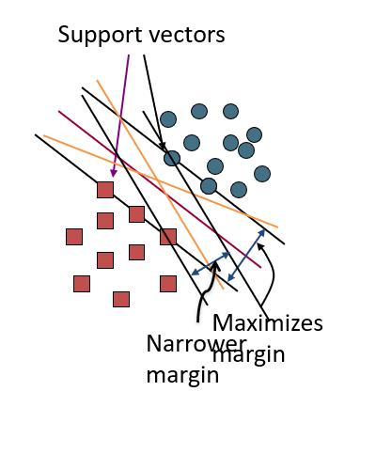
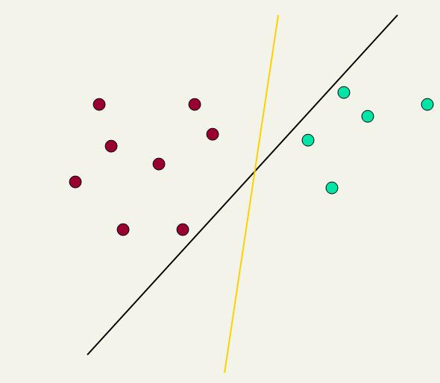

Slide 11
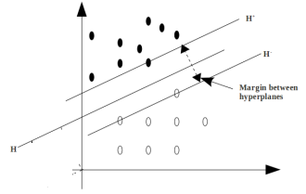
What is Separating Margin?
H is the separating hyperplane
H⁺ is the plane parallel to H and passing through the nearest +ve points to H
H⁻ is the plane parallel to H and passing through the nearest -ve points to H
Separating margin is the distance between H⁺ and H⁻
We choose H that has the maximum margin.

Slide 12
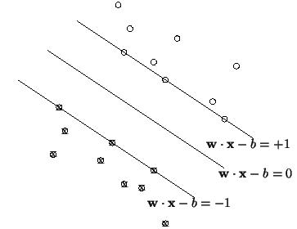
Define the hyperplane H such that:
x_{i}•w+b ≥ +1 when y_{i} =+1
x_{i}•w+b ≤ -1 when y_{i} =-1
H1
H1 and H2 are the planes:
H1: x_{i}•w+b = +1
H2: x_{i}•w+b = -1
The points on the planes H1 and H2 are the Support Vectors
H2
d⁺
d⁻
H
d+ = the shortest distance to the closest positive point
d- = the shortest distance to the closest negative point
The margin of a separating hyperplane is d⁺ + d⁻.

Slide 13
Maximizing the margin
We want a classifier with as big margin as possible.
H1
H
H2
Recall the distance from a point(x₀,y₀) to a line:
Ax+By+c = 0 is|A x₀ +B y₀ +c|/sqrt(A²+B²)
d+
d-
The distance between H and H1 is:
|w•x+b|/||w||=1/||w||
The distance between H1 and H2 is: 2/||w||
In order to maximize the margin, we need to minimize ||w||. With the
condition that there are no datapoints between H1 and H2:
x_{i}•w+b ≥ +1 when y_{i} =+1
x_{i}•w+b ≤ -1 when y_{i} =-1 Can be combined into yi(x_{i}•w) ≥ 1

Slide 14
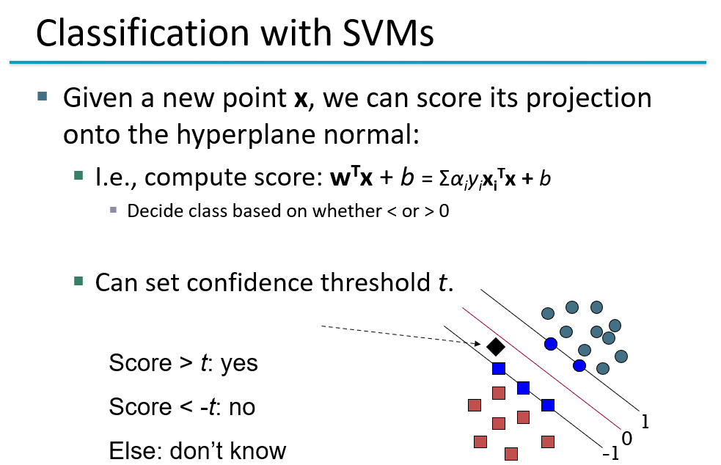

Slide 15
SVM-KNN Discriminative Nearest Neighbor Classification for Visual Category Recognition

Slide 16
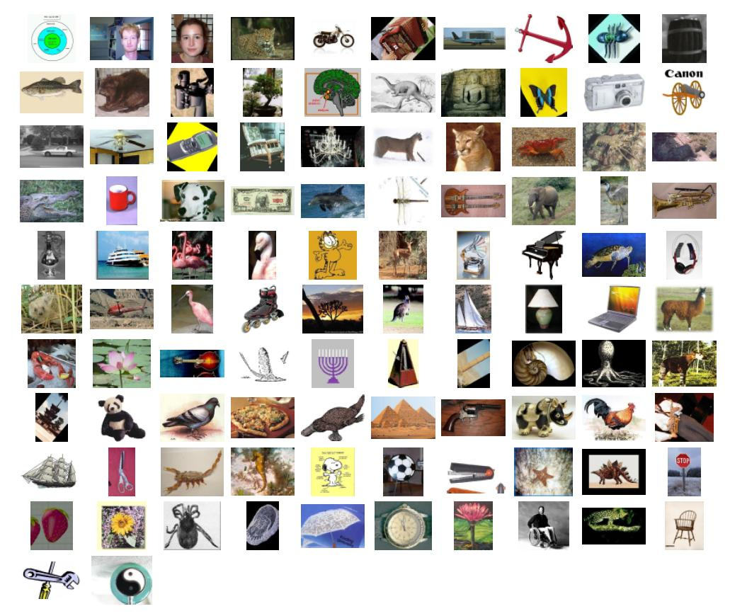
Multi-class Image Classification

Slide 17
